Slide 1
Formatted and Unformatted Input/Output functions in C

Slide 2
Formatted I/O functions are used to take various inputs from the user and display multiple outputs to the user.
These types of I/O functions can help to display the output to the user in different formats using the format specifiers.

Slide 3
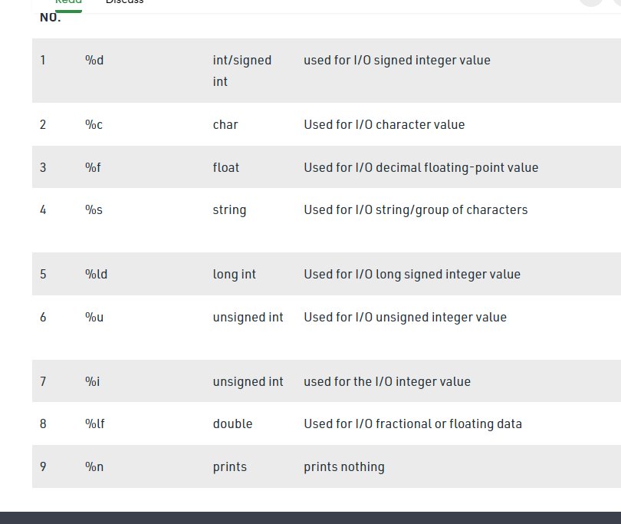

Slide 4
The following formatted I/O functions will be discussed in this section-
printf()
scanf()
sprintf()
sscanf()

Slide 5
printf():
printf() function is used in a C program to display any value like float, integer, character, string, etc on the console screen.
It is a pre-defined function that is already declared in the stdio.h(header file).
Syntax 1:
To display any variable value.
printf(“Format Specifier”, var1, var2, …., varn);

Slide 6
scanf():
scanf() function is used in the C program for reading or taking any value from the keyboard by the user, these values can be of any data type like integer, float, character, string, and many more.
This function is declared in stdio.h(header file), that’s why it is also a pre-defined function.
In scanf() function we use &(address-of operator) which is used to store the variable value on the memory location of that variable.

Slide 7
Syntax:
scanf(“Format Specifier”, &var1, &var2, …., &varn);

Slide 8
sprintf():
sprintf stands for “string print”. This function is similar to printf() function but this function prints the string into a character array instead of printing it on the console screen.
Syntax:
sprintf(array_name, “format specifier”, variable_name);

Slide 9
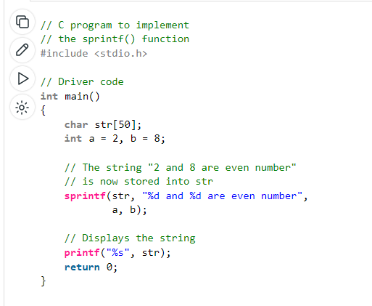

Slide 10
sscanf():
sscanf stands for “string scanf”. This function is similar to scanf() function but this function reads data from the string or character array instead of the console screen.
Syntax:
sscanf(array_name, “format specifier”, &variable_name);

Slide 11
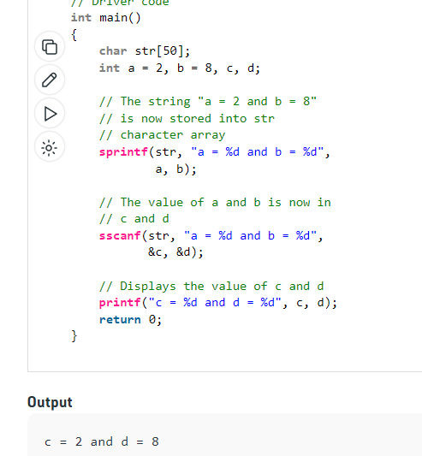

Slide 12
Unformatted Input/Output functions
Unformatted I/O functions are used only for character data type or character array/string and cannot be used for any other datatype.
These functions are used to read single input from the user at the console and it allows to display the value at the console.

Slide 13
Why they are called unformatted I/O?
These functions are called unformatted I/O functions because we cannot use format specifiers in these functions and hence, cannot format these functions according to our needs.
getch()
getche()
getchar()
putchar()
gets()
puts()
putch()

Slide 14
getch()
function reads a single character from the keyboard by the user but doesn’t display that character on the console screen and immediately returned without pressing enter key.
This function is declared in conio.h(header file). getch() is also used for hold the screen.
getch();
or
variable-name = getch();

Slide 15
getche():
function reads a single character from the keyboard by the user and displays it on the console screen and immediately returns without pressing the enter key.
This function is declared in conio.h(header file).
getche();
or
variable_name = getche();

Slide 16
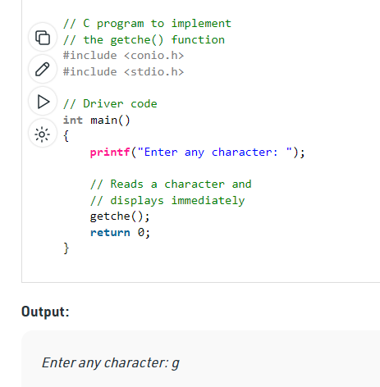

Slide 17
getchar():
function is used to read only a first single character from the keyboard whether multiple characters is typed by the user and this function reads one character at one time until and unless the enter key is pressed.
This function is declared in stdio.h(header file)
Variable-name = getchar();

Slide 18
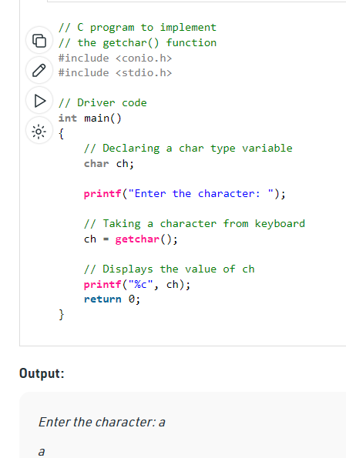

Slide 19
putchar
function is used to display a single character at a time by passing that character directly to it or by passing a variable that has already stored a character.
This function is declared in stdio.h(header file)
putchar(variable_name);

Slide 20
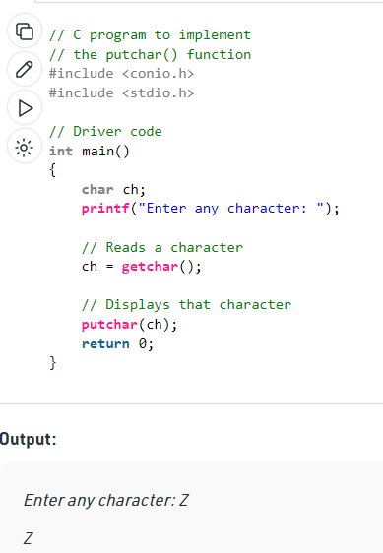

Slide 21
gets():
gets() function reads a group of characters or strings from the keyboard by the user and these characters get stored in a character array.
This function allows us to write space-separated texts or strings.
This function is declared in stdio.h(header file).

Slide 22
Syntax:
char str[length of string in number]; //Declare a char type variable of any length
gets(str);

Slide 23
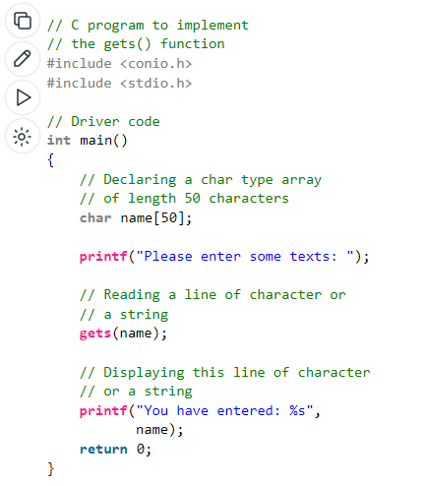

Slide 24
puts():
In C programming puts() function is used to display a group of characters or strings which is already stored in a character array. This function is declared in stdio.h(header file).
Syntax:
puts(identifier_name );

Slide 25
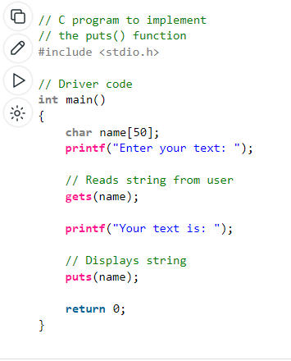

Slide 26
putch():
putch() function is used to display a single character which is given by the user and that character prints at the current cursor location.
This function is declared in conio.h(header file)
Syntax:
putch(variable_name);

Slide 27
